Slide 1

FitGeek: Modelling ML Based Recommendation System for fitness and wellness
Group No. 17
Shreya Mahajan 20104001
Saniya Dutta 20104041
Anish Bhosale 20104033
Project Guide:
Prof. Randeep Kaur Kahlon

Slide 2
Contents
Introduction
Objectives
Problem Definition
Technological Stack
Review Suggestions (Given in Last meeting)
Proposed System Architecture/Working/Methodology
Prototype Design Demonstration
Implementation Status
Status of Paper Draft & Targeted Conference
References

Slide 3
1. Introduction
FitGeek represents a new era in wellness, driven by our vision to make health and fitness universally achievable.
FitGeek simplifies the wellness journey, offering science-based solutions, personalized plans, and a dash of fun.
FitGeek's personalized fitness plans, powered by cutting-edge technology, cater to individual preferences and goals.
FitGeek’s vibrant community of fitness enthusiasts and experts provides motivation and shared experiences.
FitGeek has an ever-expanding library of educational content, we empower users to make informed health and fitness choices.
FitGeek is a lifelong commitment to your well-being, making fitness an attainable and enjoyable journey for all.

Slide 4
2. Objectives
To Provide Convenient and Economical Fitness Guidance: To offer affordable and easily accessible fitness guidance.
To Offer Instructional Exercises with Animations: To provide exercises with clear instructions, animated demonstrations and on a timer.
To Raise Awareness About Healthcare Updates: To inform and raise awareness about recent healthcare updates.
To Enable Remote Access to Exercises and hydration calculator: To facilitate remote access to exercises via web.
To Implement Disease Predictors: To include disease predictors for conditions like diabetes and stress, along with relevant recommendations.
To Offer Personalised Diet Recommendations: To provide tailored diet recommendations based on the person’s body statistics.
To calculate stress levels of the user: To create a tab where the user can get access to various mental health practices.

Slide 5
3. Problem Definition
Widespread reliance on irrelevant or inaccurate fitness information and incorrect workout plans found on the internet.
This dependence on internet sources can lead to serious injuries or ineffective workouts that do not suit individual body types.
Access to proper fitness guidance is economically unfeasible for many individuals.

Slide 6




4. Technology Stack
Frontend : WEB X.O
1. HTML : for structure
2. CSS : for styling
3. JavaScript : for interactive elements
4. Bootstrap : CSS framework for responsive and attractive designs
Backend:
1. Django : framework for web application development
2. Python : for backend logic

Slide 7
4. Technology Stack
Libraries: DATA ANALYSIS
1. Pandas
2. Numpy
3. Matplotlib
For ML related features:
1. Scikit-learn : for building disease prediction models.
2. TensorFlow or PyTorch : For building recommendation and machine learning models.
5. Streamlit : for Machine Learning models.

Slide 8
4. Technology Stack
ML Algorithms:
K-Nearest Neighbors: for classification and regression tasks of the diet recommender.
Support Vector Machine: for classifying individuals into one of two classes: diabetic or non-diabetic, in the diabetes predictor.
Content-Based Filtering: for exercise recommendation system based on the three categories: Beginner, Intermediate and Expert level of the user.
Natural Language Processing: to determine the stress levels of the user based on the inputs provided.
Logistic Regression: to classify those stress levels into different classes (e.g., low, moderate, high).

Slide 9
5. Review Suggestions (Given in Last Meeting)
Email Verification
Presentation changes (Literature Review in table, Recent year papers, Introduction in points)
Gmail signup
Exercise dataset
Add Confirm Password

Slide 10
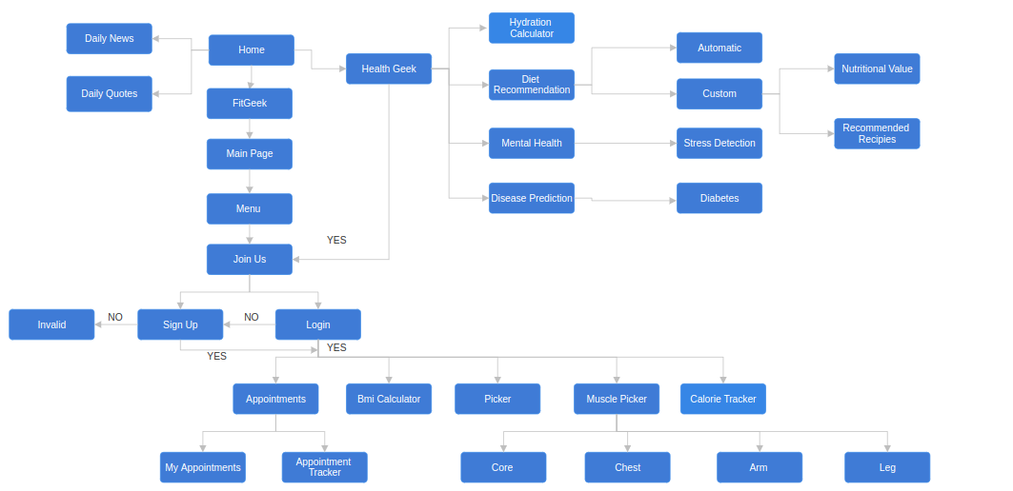
6. Proposed System Architecture

Slide 11

7. Prototype Design Demonstration

Slide 12


Slide 13
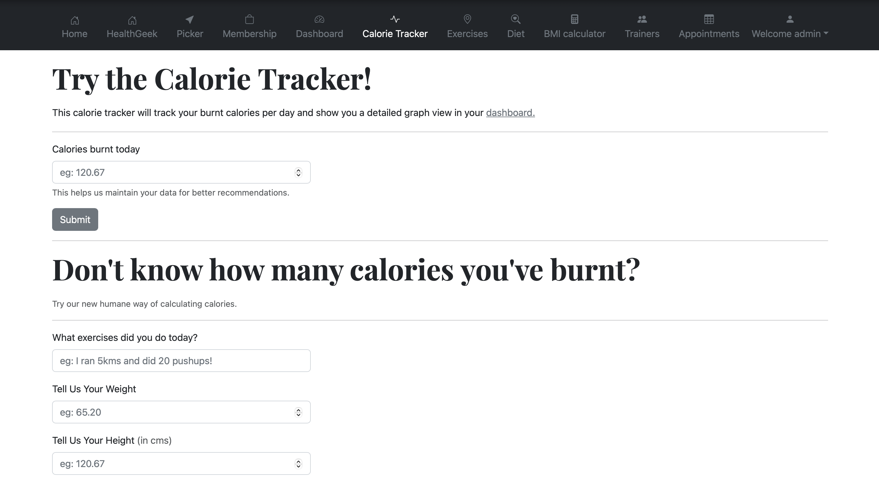

Slide 14
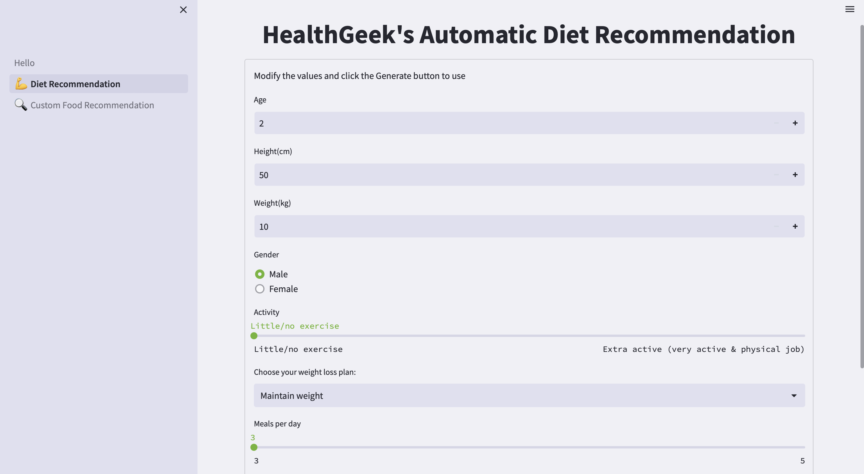

Slide 15
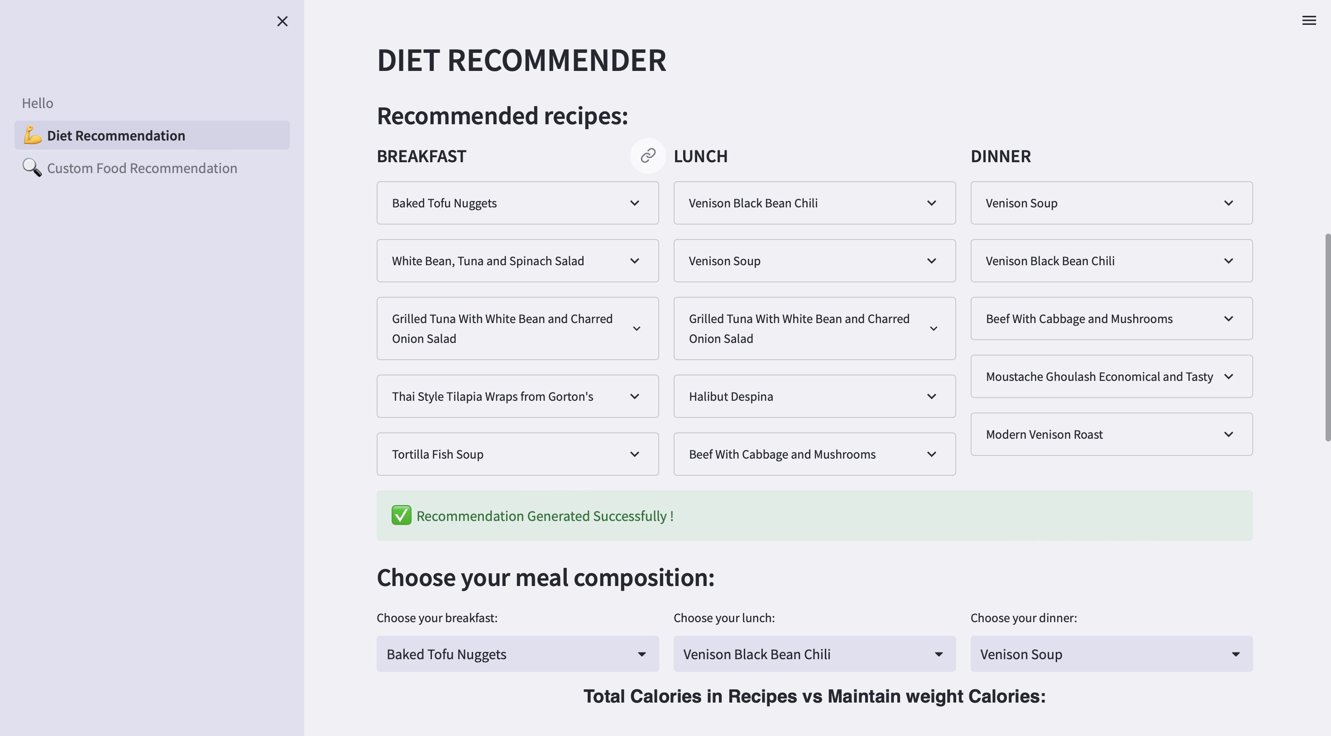

Slide 16
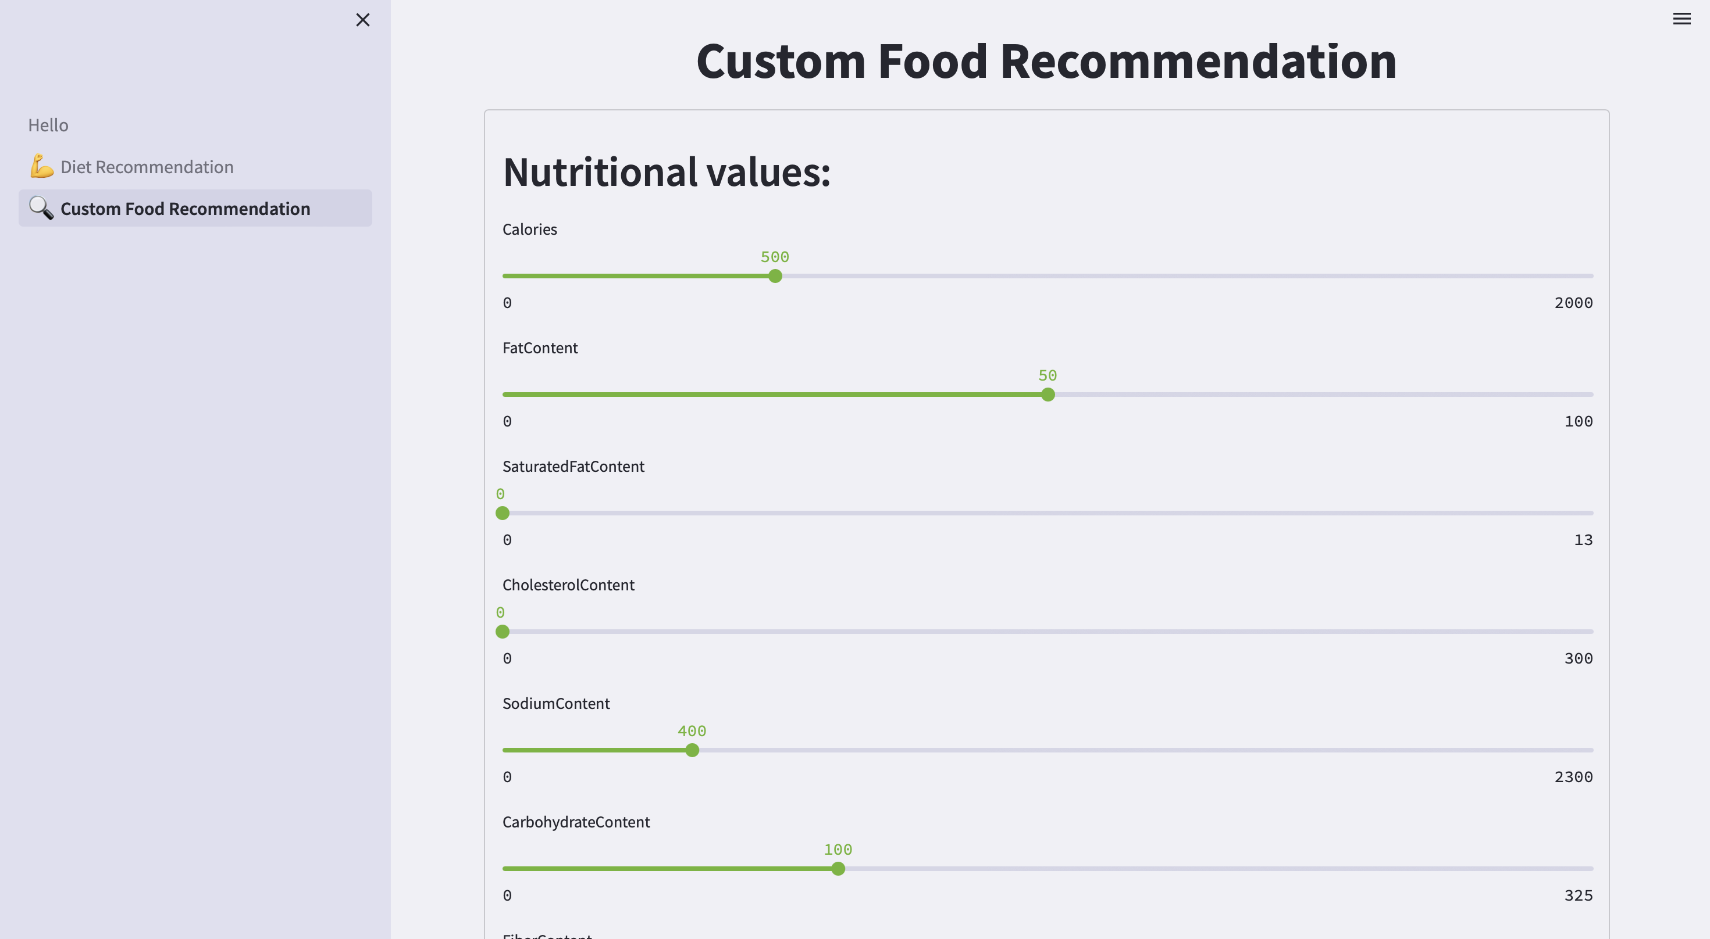

Slide 17
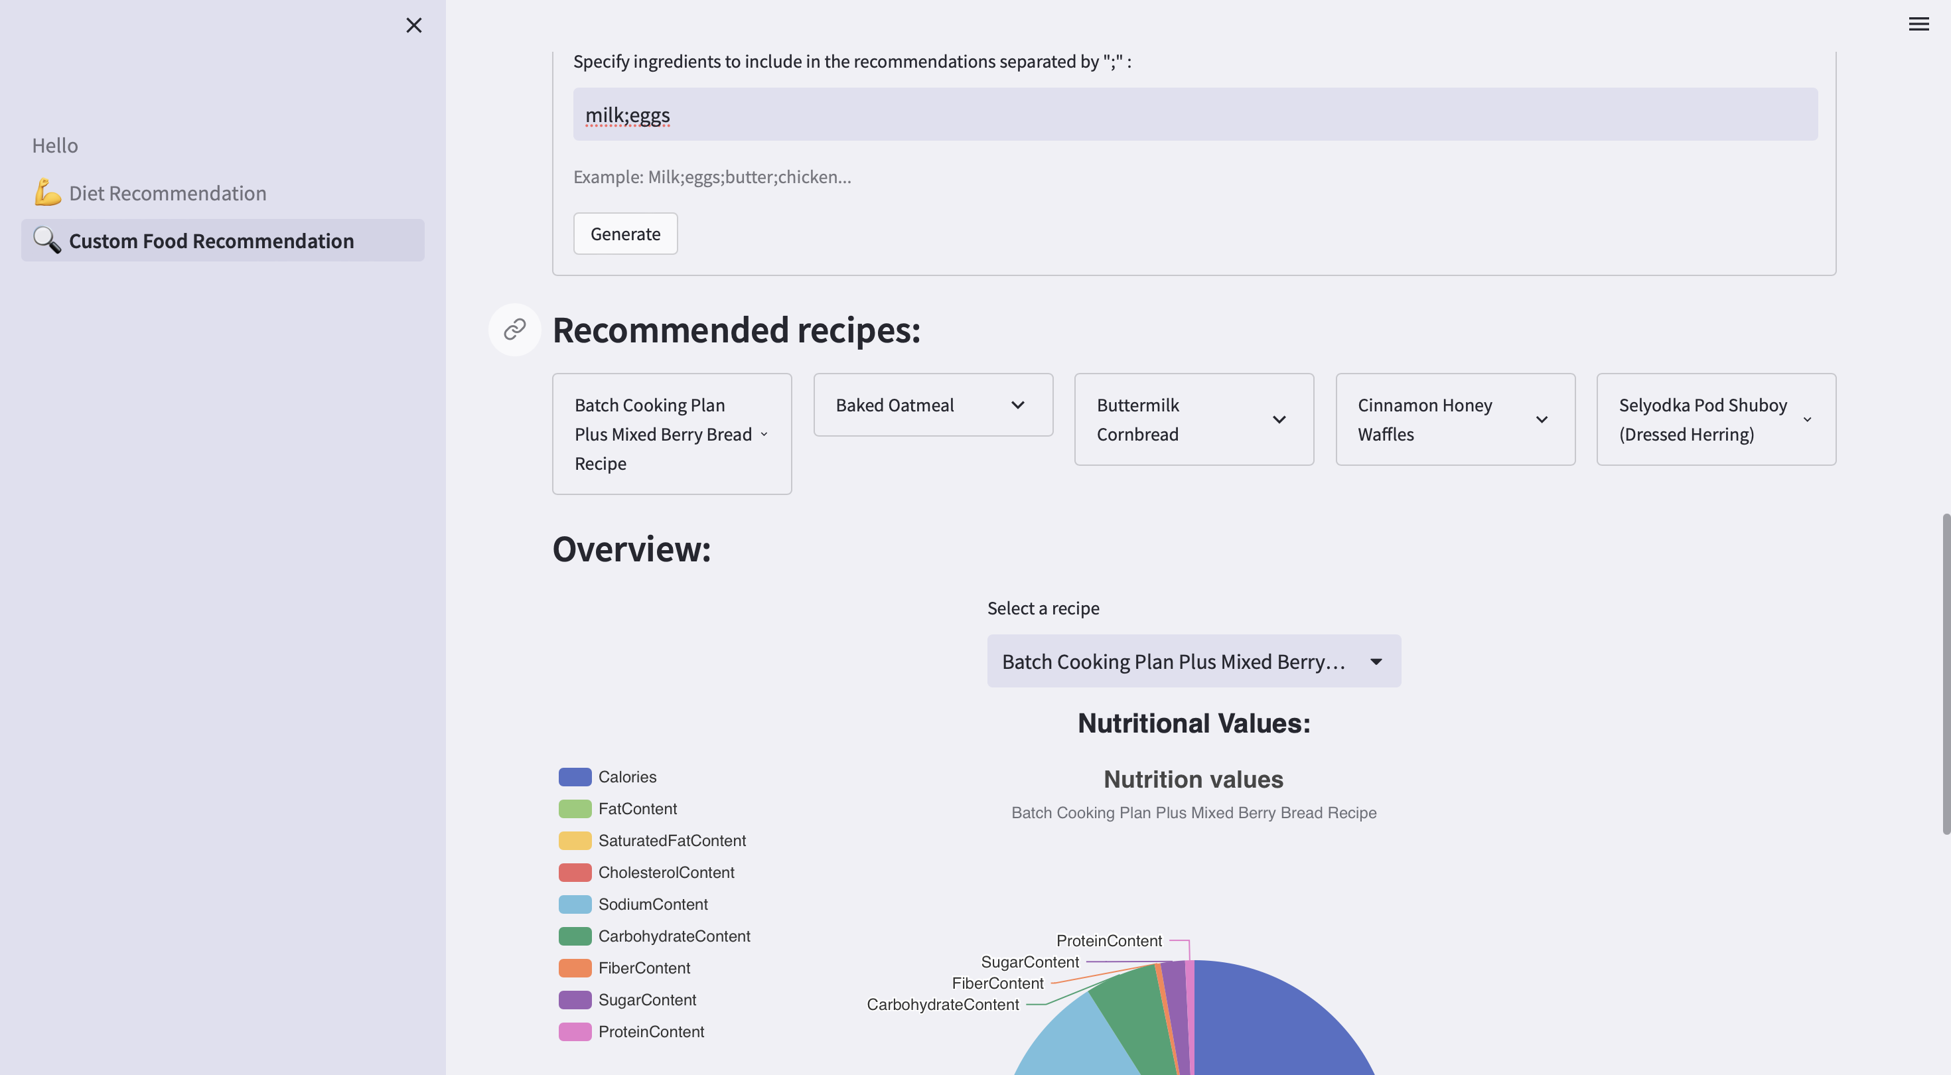

Slide 18
8. Implementation Status
Achieved around 45-50% completion in the implementation phase.
Successfully developed a comprehensive dashboard covering all required fields.
Finished preparing the majority of pages within the dashboard.
Significant progress made in establishing a strong foundation for the project.

Slide 19
9. Status of Paper Draft & Targeted Conference
Our research and paper drafting have commenced, marking the first steps in our academic journey towards a comprehensive and insightful study.
The International Conference on Emerging Trends and Technologies on Intelligent Systems (ETTIS) will be held in March 2024. The conference is indexed in Scopus and will be sponsored by Springer. The conference will cover a wide range of topics, including intelligent systems, artificial intelligence, and machine learning. The conference will be of interest to researchers, practitioners, and policymakers in the field of computer science. The Call For Paper Deadline is March 14, 2024.
Websites reviewed: www.ettis.org/

Slide 20
10. References
N. Jain, A. K. Sharma, and N. Khare, "Comprehensive Study of Routing Protocols in Mobile Ad Hoc Networks," 2020 Second International Conference on Inventive Research in Computing Applications (ICIRCA), Coimbatore, India, 2020, pp. 635-640, doi: 10.1109/ICIRCA49882.2020.10074213.
S. Kumar, R. Chauhan and N. Kumar, "Survey and Comparative Analysis of Energy Efficient MAC Protocols for WSN," 2020 International Conference on Smart Electronics and Communication (ICOSEC), Trichy, India, 2020, pp. 647-651, doi: 10.1109/ICOSEC49091.2020.9195622.
S. Raza, M. Akbar, M. Akhtar, M. Ismail, and M. J. Gondal, "Energy-Efficient Routing Protocols in Wireless Sensor Networks: A Survey," 2021 IEEE Access, vol. 9, pp. 29526-29548, 2021, doi: 10.1109/ACCESS.2021.3066002.
P. Lal, R. Kumar and R. Kumar, "A Comprehensive Study and Comparative Analysis of QoS in Ad Hoc Networks," 2017 9th International Conference on Computational Intelligence and Communication Networks (CICN), Gwalior, India, 2017, pp. 188-192, doi: 10.1109/CICN.2017.8260796.

Slide 21
10. References
K. Agrawal, G. B. Singha and A. K. Luhach, "A Comprehensive Survey of Mobile Agent Migration in WSNs," 2012 Ninth International Symposium on Pervasive Systems, Algorithms and Networks, San Marcos, TX, USA, 2012, pp. 118-123, doi: 10.1109/I-SPAN.2012.6265373.
A. S. Pillai, V. Wagh and R. H. Goudar, "Survey of Routing Protocols in Mobile Adhoc Network," 2009 International Conference on Computer and Communication Technology, Allahabad, India, 2009, pp. 96-100, doi: 10.1109/ICCCT.2009.5192325.

Slide 22
Thank you!

